Slide 1
OPULS
Town Hall
Thursday @ 3:30
Notes:
I want to describe the OPULS project and invite you to attend the Town Hall meeting we're having on Thursday where we will solicit input for the project's direction.

Slide 2
OPeNDAP
Unidata
NOAA
Notes:
What is OPULS? The name "OPULS" stands for "OPeNDAP/Unidata Linked Servers" and, as the name suggests, it is a joint project between OPeNDAP and Unidata, funded by NOAA, to develop a new level of data-access functionality. However, when you read the project summary, one thing stands out - data.

Slide 3
Notes:
The goals of OPULS are to embrace data provision, using web services, and data access, via browsers and applications. By integrating data provision more tightly with existing web services, we will simplify integrating data with the larger web ecosystem.

Slide 4
data analysis
&
synthesis
Notes:
At the same time, supporting access using applications (and not just browsers) is a valuable underpinning for data analysis and even data synthesis (i.e., creating new data by merging or otherwise adding value to existing data).

Slide 5
data
web
&
your input
Notes:
I will cover three things today: First how our work in OPULS will enable more data to be accessed; Second, how widely used web services will make that access more powerful; and third, how you can participate in the ongoing effort - without attending a single telecon ;-)

Slide 6
data model
DAP4
web services
Notes:
The technology emerging from OPULS is called DAP4 - a successor to DAP2 - and is a set of specifications and/or protocols for a data model and a set of web services.

Slide 7
Notes:
A data model is an abstraction detailing how data are organized and accessed. A data model is akin to a data structure. This fostered DAP2’s close association with programming languages and DAP4 extends the tradition.

Slide 8
Neutral
Specific
Domain
Notes:
Data access is often characterized as either domain-neutral or domain specific. In fact, those are not really two different access modes, but two different data models. A domain-neutral data model organizes information based on general computational requirements - similar to a programming language.

Slide 9
Neutral
Specific
Domain
Notes:
A domain-specific model organizes information for use within a given domain based on common practices.

Slide 10
interoperability
Notes:
Why use domain-neutral data models? Because they provide a very high degree of mechanical interoperability and thus can be used to transport data that use a number of different domain-specific models.

Slide 11
layers
Notes:
What does this have to do with OPULS? DAP4 uses a domain-neutral data model but will add higher layers that embody additional semantics. DAP4 will retain a high level of machine-level interoperability through the lower layer.

Slide 12
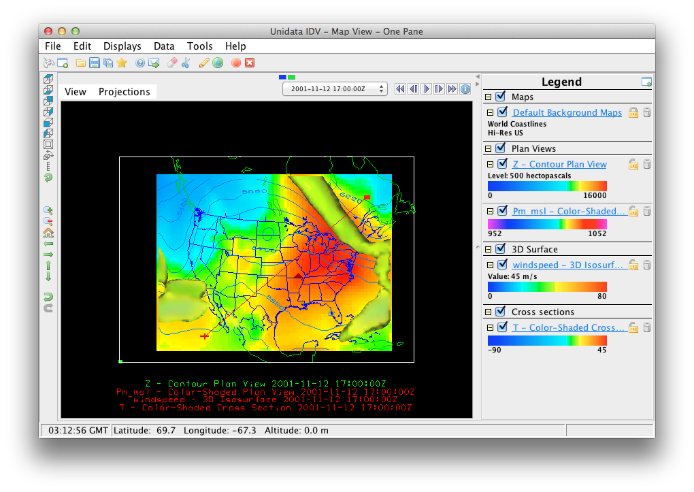
Notes:
Practically speaking, this means that tools like IDV or Matlab will be able to access a wider range of data using DAP4 than they can now using DAP2.

Slide 13
catalog
search
subscription
Notes:
However, DAP4 goes further than DAP2 in other ways. DAP2 largely ignored everything but access, leaving cataloging, searching, and subscription services up to the other efforts.

Slide 14
web services
ecosystem
Notes:
In addition to a more comprehensive data model, DAP4 also will specify a richer set of // web services than its predecessor. It will utilize the existing web-services ecosystem, exploiting Atom, OpenSearch, the Linked Open Data effort and more.
We have just begun to investigate these web services and our town hall session will solicit input on which are most important.

Slide 15
server processing
(functions)
Notes:
DAP servers that offer processing capabilities already have been successful in several contexts but each implementation has been unique and this reduces interoperability.

Slide 16
standardization
=
utility
Notes:
. Despite the technical challenges, we think greater standardization of processing capabilities can elevate online data access to a new level of utility.

Slide 17
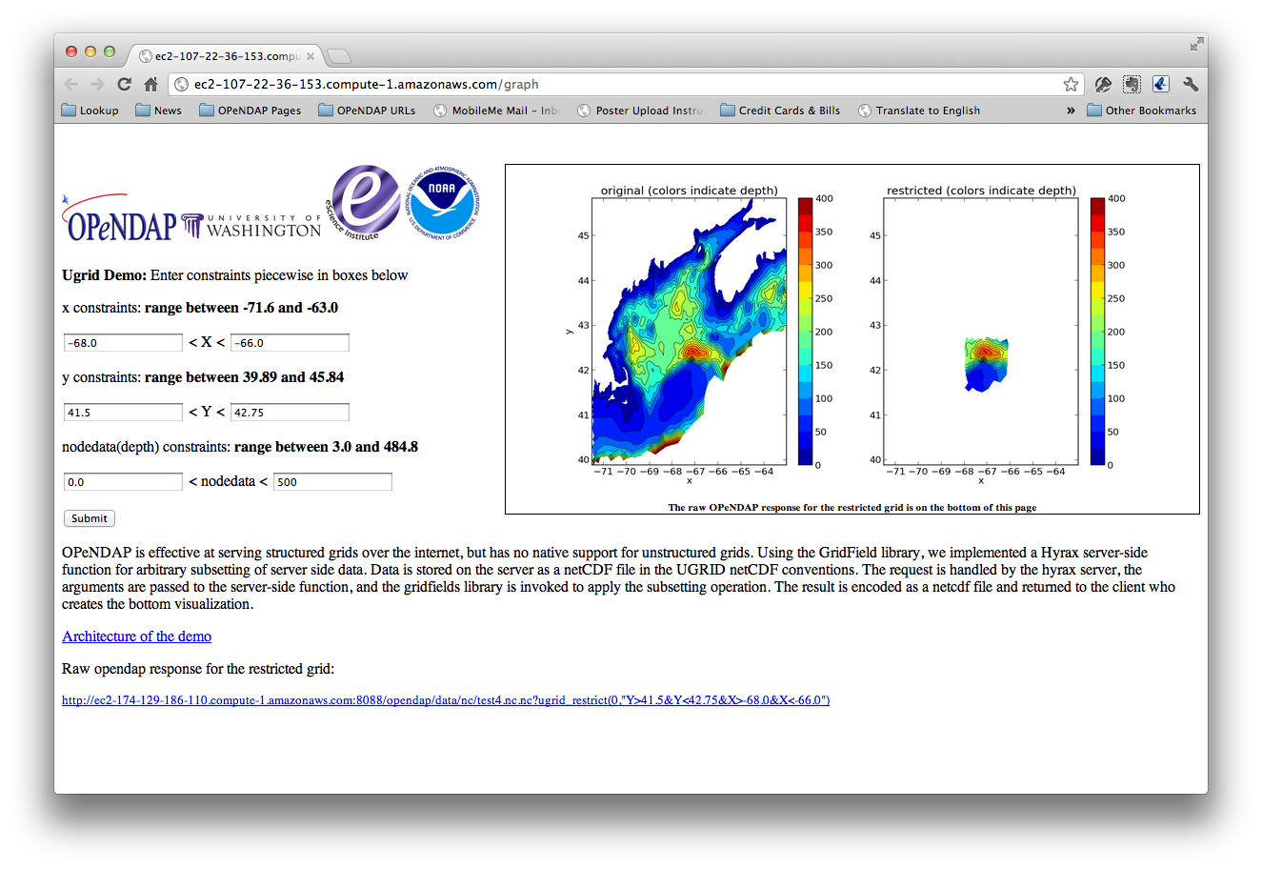
Notes:
The OPULS project includes a subsetting facility for irregular-meshes . We have implemented this as a server function. While this is an important capability, it is only the beginning of what is possible.

Slide 18
Notes:
In OPULS we are seeking community input for both web services and server processing functions. We want to know what should be part of the DAP4 protocol suite based on your experience.

Slide 19
Notes:
Tomorrow we will hold a Town Hall meeting where you can provide input. Which of the common web services can/should be integrated into DAP4 and which server functions would be most useful?

Slide 20
Town Hall
Rm 227
Thursday @ 3:30

