Slide 1
Coverages and the DAP2 Data Model
James Gallagher
22 March 2012

Slide 2
Outline
DAP2 data model
Servers and their relation to the data model
Coverages and DAP2
Support for Quadrilateral Grids
Other kinds of grids
Example: UGrid work with NOAA

Slide 3
The Data Model versus Servers
Data Model
Variables
Operations
Datasets
Servers
Software that implements the operations and which provides other features
Expressions combine variables, referenced by name, and operators to constrain access.
Variables and their Operations provide a collection of Abstract Datatypes.
URLs provide unique references to Datasets and Servers used to access them.

Slide 4
The Data Model and Application Domains
DAP2 is domain neutral
DAP2 is intended to be a lower level in a multi-tier protocol stack
Examples of standards often used with DAP2:
COARDS
CF
HDF-EOS; HDF-EOS2
The separation is intentional!

Slide 5
Data Model
Variables:
Name, Type, Shape: syntactic metadata
Attributes (name-type-value triples): semantic metadata
Value(s)
Operations:
The operations that can be performed on the variables (subset, sample and function invocation)
Datasets:
Instantiations of Variables

Slide 6
Datatypes in DAP2
Types found in a ‘typical’ programming language
Structures: define new lexical scopes; contain one or more other variables; recursive
Arrays: type-homogeneous; indexed; n-dimensional; includes arrays of structures
Scalars: the fundamental building blocks; Byte, …, String, URL.
Sequence: Relational type; may be nested; defines a lexical scope; like structure, can contain one or more other variables; recursive (so nesting of relations is possible);
Grid: Similar to a ‘quadrilateral coverage;’ defines a lexical scope; is not recursive.

Slide 7
Aside: Lexical Scope
Structure {
Int32 x;
Structure {
Int32 x, y;
} point;
} x[1024];
Lexical scoping prevents name ‘collisions’
Provides hierarchy
Provides grouping

Slide 8
Aside: Lexical Scope
Structure {
Int32 x;
Structure {
Int32 x, y;
} point;
} x[1024];
The above example defines 3 lexical scopes:
The outermost, which contains the Structure x
The things contained by the Structure x
The things contained by the Structure point
Some Fully Qualified Names:
Assume that the dot operator has its typical meaning…
x, x.x, x.point.x

Slide 9
Aside: Lexical Scope
Structure {
Int32 x;
Structure {
Int32 x, y;
} point;
} x[1024];
The above example defines 3 lexical scopes:
The outermost, which contains the Structure x
The things contained by the Structure x
The things contained by the Structure point
Some Fully Qualified Names:
Assume that the dot operator has its typical meaning…
x, x.x, x.point.x

Slide 10
Aside: Lexical Scope
Structure {
Int32 x;
Structure {
Int32 x, y;
} point;
} x[1024];
The above example defines 3 lexical scopes:
The outermost, which contains the Structure x
The things contained by the Structure x
The things contained by the Structure point
Some Fully Qualified Names:
Assume that the dot operator has its typical meaning…
x, x.x, x.point.x

Slide 11
Aside: Lexical Scope
Structure {
Int32 x;
Structure {
Int32 x, y;
} point;
} x[1024];
The above example defines 3 lexical scopes:
The outermost, which contains the Structure x
The things contained by the Structure x
The things contained by the Structure point
Some Fully Qualified Names:
Assume that the dot operator has its typical meaning…
x, x.x, x.point.x

Slide 12
Aside: Lexical Scope
Structure {
Int32 x;
Structure {
Int32 x, y;
} point;
} x[1024];
The above example defines 3 lexical scopes:
The outermost, which contains the Structure x
The things contained by the Structure x
The things contained by the Structure point
Some Fully Qualified Names:
Assume that the dot operator has its typical meaning…
x, x.x, x.point.x

Slide 13
Aside: Lexical Scope
Structure {
Int32 x;
Structure {
Int32 x, y;
} point;
} x[1024];
The above example defines 3 lexical scopes:
The outermost, which contains the Structure x
The things contained by the Structure x
The things contained by the Structure point
Some Fully Qualified Names:
Assume that the dot operator has its typical meaning…
x, x.x, x.point.x

Slide 14
Operations
Operations provide a way to extract portions of a dataset to optimize data transfers – clients know what they want and can ask for that and no more
Operations are made up of variable names and operators and/or function calls
Operations can subset and sample arrays; extract relations from Sequences using relational operators; and call functions to compute new values using data from one or more variables.

Slide 15
Constraint Expressions
Used to select individual variables
Several variables at once
Slice and sample arrays
Select elements (rows) from Sequences
Call functions
Compose functions

Slide 16
Constraint Expression Examples
SST
SST.TIME
SST.TIME,SST.COADSX
SST.TIME[3]
SST.TIME[2:2:8]
geogrid(SST,45,-82,40,-78)
linear_scale(geogrid(SST,45,-82,40,-78),10,0)
Dataset {
Grid {
Array:
Float32 SST[12][90][180];
Maps:
Float64 TIME[TIME = 12];
Float64 COADSY[COADSY = 90];
Float64 COADSX[COADSX = 180];
} SST;
} coads_climatology;
*The real dataset for these examples is at test.opendap.org/dap/data/nc/coads_climatology.nc.
e.g.: test.opendap.org/opendap/data/nc/coads_climatology.nc.asc?linear_scale(geogrid(SST,45,-82,40,-78),10,0)

Slide 17
Constraint Expression Examples: Sequences support relational ops
&cruise=1
&cruise={1,3,5}
&cruise<6
&lat,lon
lat,lon&cruise=1
Dataset {
Sequence {
Sequence {
Float32 lat, lon;
Sequence {
Int32 depth;
Float32 temp;
} cast;
} leg;
} cruise;
} XBT_Data;

Slide 18
Datasets
Collections of variables
Each Dataset is held in a single Structure instance that holds one or more variables
Attributes defined at this top-most level and not explicitly bound to a variable are “global attributes” and convey information about the dataset as whole
Each variable in the dataset has zero or more attributes.
Attributes are lexically scoped.

Slide 19
OPeNDAP Servers often do more
DAP2 specifies two metadata responses
…and one data response (BLOB; XDR encoded)
Servers also typically return/provide:
THREDDS catalogs plus HTML pages
XML, RDF encodings for metadata
ASCII, netCDF encodings for data

Slide 20
data model = software bus
Software Bus: A programming interface that allows software modules to transfer data to each other.
Format readers decode data and produce a representation using the data model
Response builders use the data model representation
This mirrors the larger client server design where clients can read data stored in many different formats from one or more servers.

Slide 21
Summary of the Data Model
Variables: Datatypes provide ‘syntactic metadata; attributes provide semantic metadata
Datasets: Concrete collections of variables
Operations: Provide a way to use operators to extract parts of variables; based on projection, selection and function invocation
Servers provide a web interface using the data model

Slide 22
Coverages and DAP2
DAP2 ‘Grid’ provides the structure needed for a quadrilateral grid
DAP2 is ‘domain neutral’
Information about geospatial location should be provided by attributes

Slide 23
DAP2’s Grid Data type
…is a Quadrilateral Grid
“DAP2 Grid” “Maps”
Define the coverage extent
“DAP2 Grid” “Array”
Define the schema mapping
Grid lines do not have to be equally spaced
N-dimensional
Limitations
Grid lines only; curves are not supported
All Grid lines intersect at right angles

Slide 24
DAP2 Grids: Abstract and Concrete Representations
Array: Holds the ‘feature attribute value records.’ These are accessed using integer indices i₀, i₁, …, i_{n}
Map: Holds the grid points where the value of the i₀th grid point is i^{th} value of the m₀th vector.
Because the DAP2 Grid datatype uses vectors for its Maps, the Grid datatype is an ‘orthogonal grid.’

Slide 25
Continuous versus Discrete…
DAP2 provides a mechanism
It does not specify policy
Thus, ‘Grid’ can represent a variety of data abstract grid coverages.
The exact mapping – e.g., how to (or if) interpolate values ‘between the grid points’ – must be provided in attributes or by convention.

Slide 26
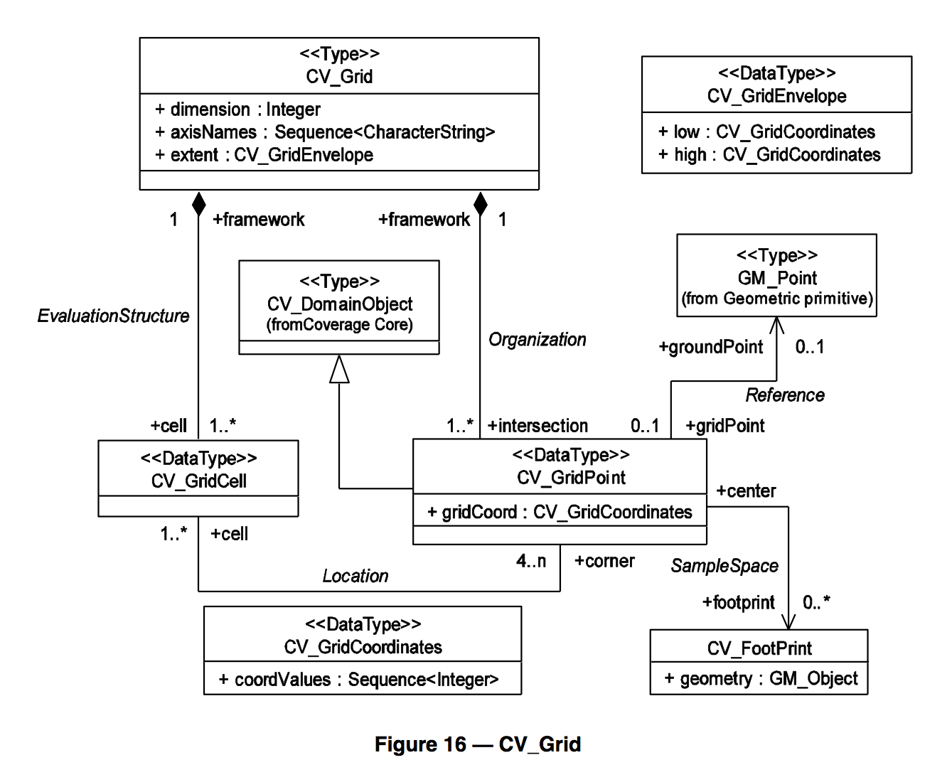
DAP2 Grid compared to CV_Grid
Figure 16 – CV_Grid. From “The OpenGIS Abstract Specification Topic 6: Schema for coverage geometry and functions,” OGC 07-001, p. 41
Figure copyright 2007 OGC, Inc.

Slide 27
DAP2 Grid compared to CV_Grid
Dimension and axisNames are present in the Grid variable’s definition.
Extent can be read from the Map vectors or from the Grid variable’s attributes.
The GridEnvelope can also be read from the Maps and Grid attributes if they are present.

Slide 28
DAP2 Grid compared to CV_Grid
The DAP2 Grid variable’s Maps provide this information.
The EvaluationStructure is implicit, however.
The extent of the Grid can be read from the Maps

Slide 29
DAP2 Grid compared to CV_Grid
GridCoordinates are held in the values stored in the Map’s

Slide 30
DAP2 Grid compared to CV_Grid
Information about the footprint of the grid cell (as defined in sec 8.2.2 of OGC 07-011) may be provided in attributes of the Grid variable

Slide 31
Representing Other Kinds of Coverages
Assumptions:
Constructor types can build the necessary data structures
DAP2 Global and Variable attributes can encode interpretation information

Slide 32
Other Kinds of Coverages, cont.
Hexagonal Grid
Can be implemented using DAP2’s Grid variable and extra attribute information.
Thiessen polygon
Triangular irregular networks (TINs)
Both can be encoded using the conventions being developed by ASA & Deltares (http://bit.ly/ugrid_cf)

Slide 33
Summary
DAP2 data model is domain neutral
Provides structural support for quadrilateral grids
Can be used to encode a wide variety of coverages
Domain neutral design can leverage other application-specific standards
Domain neutral design fosters cross-domain interoperability

